Slide 1

Chapter 2
Mathematical background – part 1

Slide 2
Outlines
Integer Arithmetic.
Modular Arithmetic.
Matrices (Optional).

Slide 3
Learning Objectives
In the end of this Chapter 2, students should be able:
To perform integer arithmetic, including binary operations, integer division, greatest common divisor, and divisibility.
To perform modular arithmetic, including congruences, additive and multiplicative inverses.
To review and perform operations on matrices, both in integer and modular arithmetic environments.

Slide 4
INTEGER ARITHMETIC

Slide 5

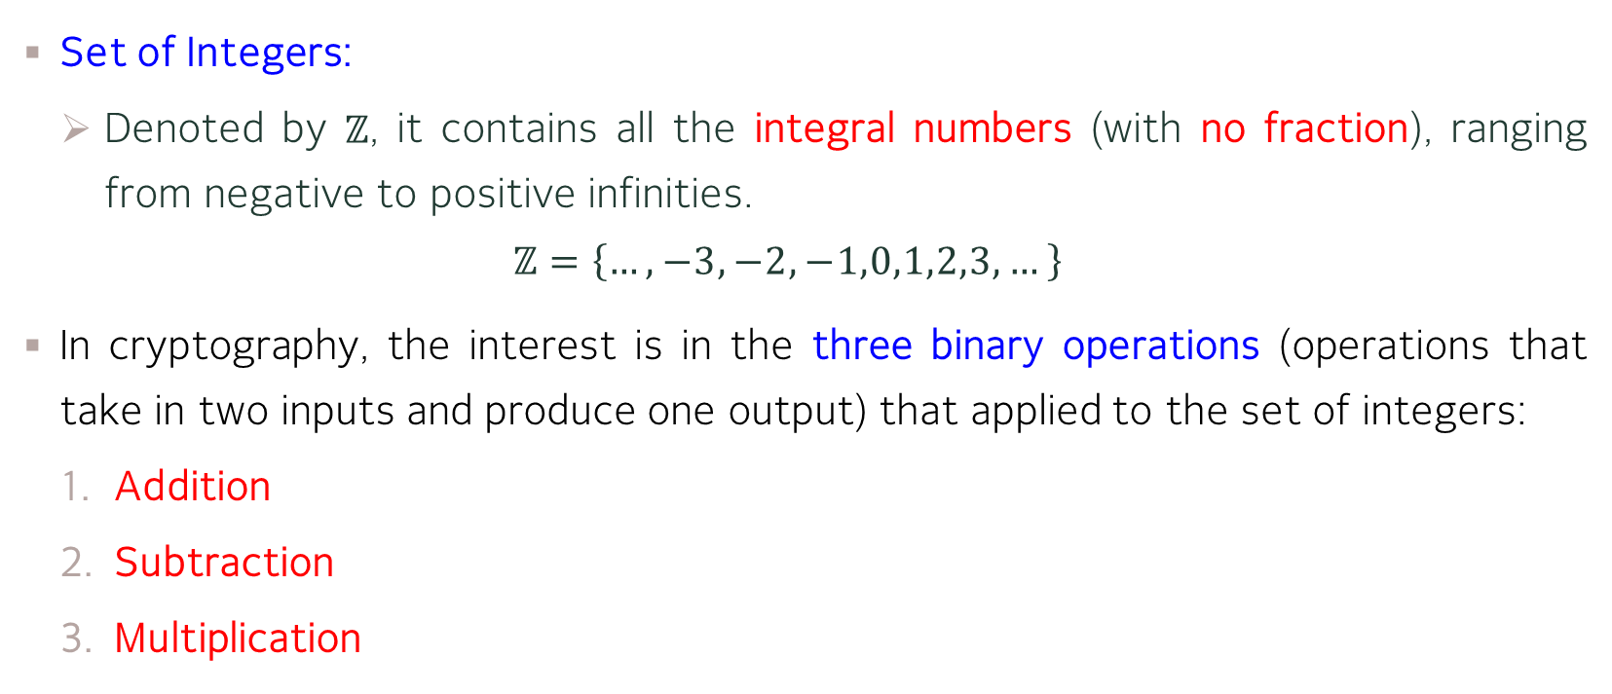
Integers and Binary Operations
Set of Integers:
Denoted by $ℤ$, it contains all the integral numbers (with no fraction), ranging from negative to positive infinities.
$$ℤ=\left\{…, −3, −2,−1,0,1,2,3,…\right\}$$
In cryptography, the interest is in the three binary operations (operations that take in two inputs and produce one output) that applied to the set of integers:
Addition
Subtraction
Multiplication
Why Division is NOT part of the binary operations?

Slide 6
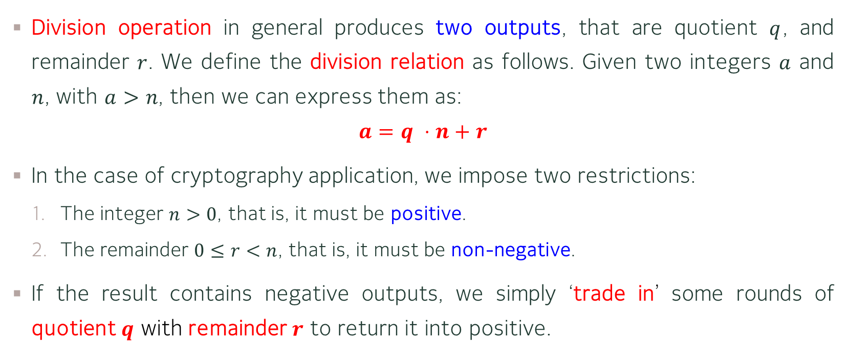
Integer Division
Division operation in general produces two outputs, that are quotient $q$, and remainder $r$. We define the division relation as follows. Given two integers $a$ and $n$, with $a>n$, then we can express them as:
$$a=q ⋅n+r$$
In the case of cryptography application, we impose two restrictions:
The integer $n>0$, that is, it must be positive.
The remainder $0≤r<n$, that is, it must be non-negative.
If the result contains negative outputs, we simply ‘trade in’ some rounds of quotient $q$ with remainder $r$ to return it into positive.

Slide 7

Divisibility
From division relation $a=q ⋅n+r$, if the remainder $r=0$, then we have:
$$a=q⋅n$$
and we say that $n$ divides $a$, or mathematically $n | a$. Otherwise, $n∤a$.
Examples:
$32=8×4$. Hence, $4 | 32$, or $8 | 32$.
$38=9×4+2$. Hence, $4∤38$, or $9∤38$.

Slide 8
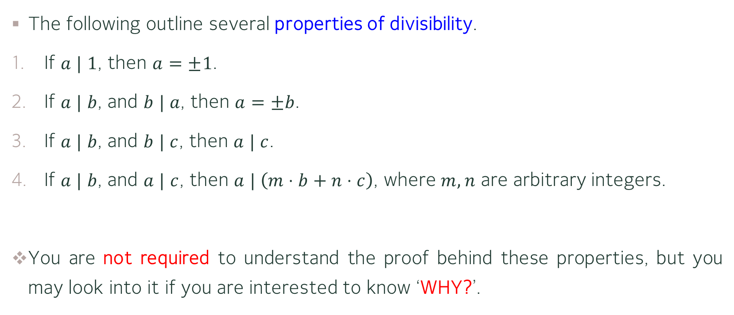
Divisibility – Properties
The following outline several properties of divisibility.
If $a | 1$, then $a=±1$.
If $a | b$, and $b | a$, then $a=±b$.
If $a | b$, and $b | c$, then $a | c$.
If $a | b$, and $a | c$, then $a | \left(m⋅b+n⋅c\right)$, where $m,n$ are arbitrary integers.
You are not required to understand the proof behind these properties, but you may look into it if you are interested to know ‘WHY?’.

Slide 9
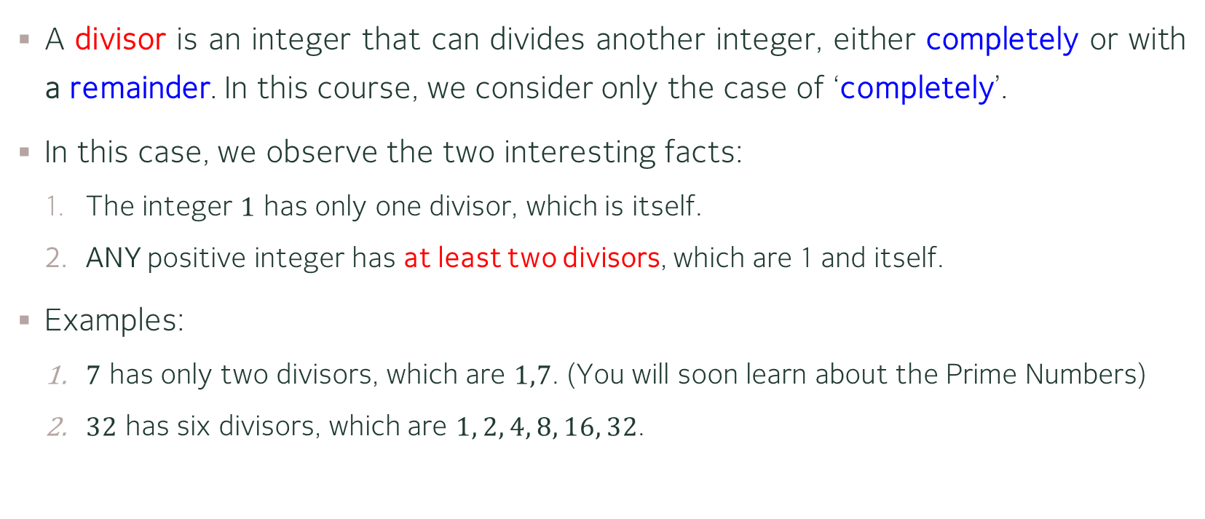
Divisibility – Divisors
A divisor is an integer that can divides another integer, either completely or with a remainder. In this course, we consider only the case of ‘completely’.
In this case, we observe the two interesting facts:
The integer $1$ has only one divisor, which is itself.
ANY positive integer has at least two divisors, which are 1 and itself.
Examples:
$7$ has only two divisors, which are $1,7$. (You will soon learn about the Prime Numbers)
$32$ has six divisors, which are $1, 2, 4, 8, 16, 32$.

Slide 10

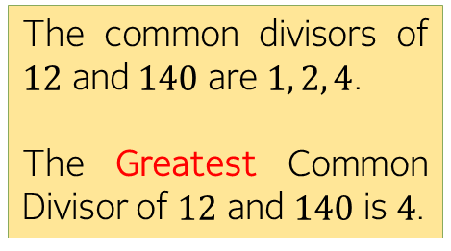
Divisibility – Greatest Common Divisor
In cryptography, the one that we are needed is the greatest common divisor, or simply $\gcd{ }$of two (or more) positive integers.
Any two integers may have many common divisors, but only one GREATEST (largest) common divisor.
The common divisors of $12$ and $140$ are $1, 2, 4$.
The Greatest Common Divisor of $12$ and $140$ is $4$.

Slide 11
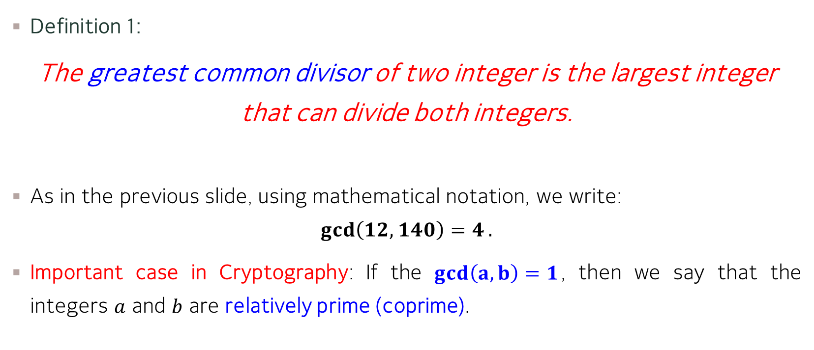
Divisibility – Greatest Common Divisor
Definition 1:
The greatest common divisor of two integer is the largest integer that can divide both integers.
As in the previous slide, using mathematical notation, we write:
$$\gcd\left(12,140\right)=4.$$
Important case in Cryptography: If the $gcd\left(a,b\right)=1$, then we say that the integers $a$ and $b$ are relatively prime (coprime).

Slide 12
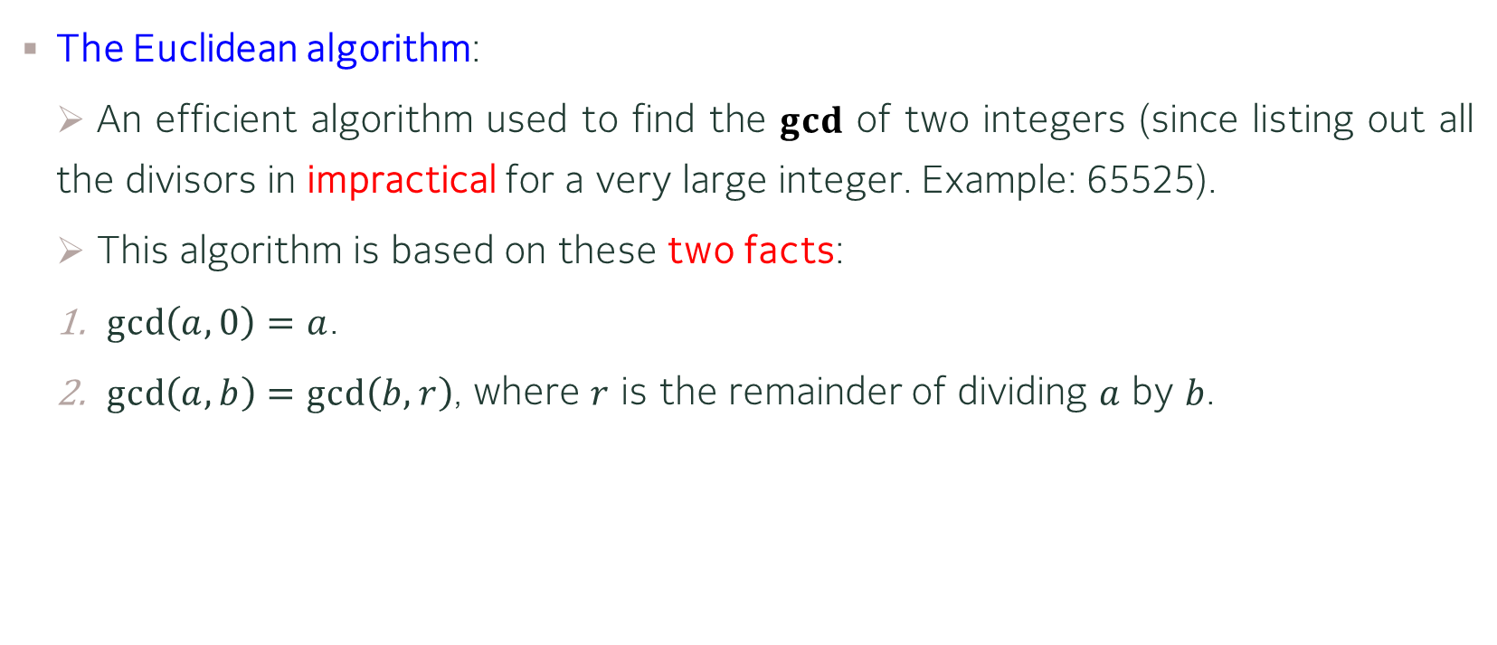
Divisibility – The Euclidean Algorithm
The Euclidean algorithm:
An efficient algorithm used to find the $gcd$ of two integers (since listing out all the divisors in impractical for a very large integer. Example: 65525).
This algorithm is based on these two facts:
$\gcd\left(a,0\right)=a$.
$\gcd\left(a,b\right)=\gcd\left(b,r\right)$, where $r$ is the remainder of dividing $a$ by $b$.

Slide 13
Divisibility – The Euclidean Algorithm

Slide 14
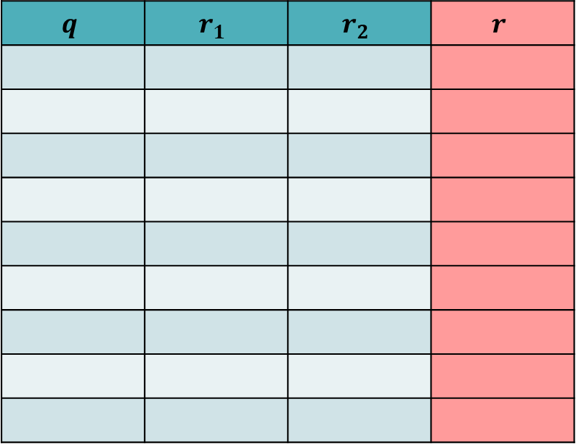

Divisibility – The Euclidean Algorithm
Example 1: Find the $gcd$ of $2740$ and $1760$.
$$q$$ | $$r_{1}$$ | $$r_{2}$$ | $$r$$

Slide 15

Divisibility – The Euclidean Algorithm
Example 1: Find the $gcd$ of $2740$ and $1760$.
Hence, $\gcd\left(2740,1760\right)=20$.

Slide 16

Divisibility – The Euclidean Algorithm
Example 2: Find the $gcd$ of $25$ and $60$.
$$q$$ | $$r_{1}$$ | $$r_{2}$$ | $$r$$

Slide 17

Divisibility – The Euclidean Algorithm
Example 2: Find the $gcd$ of $25$ and $60$.
Hence, $\gcd\left(25,60\right)=5$.

Slide 18
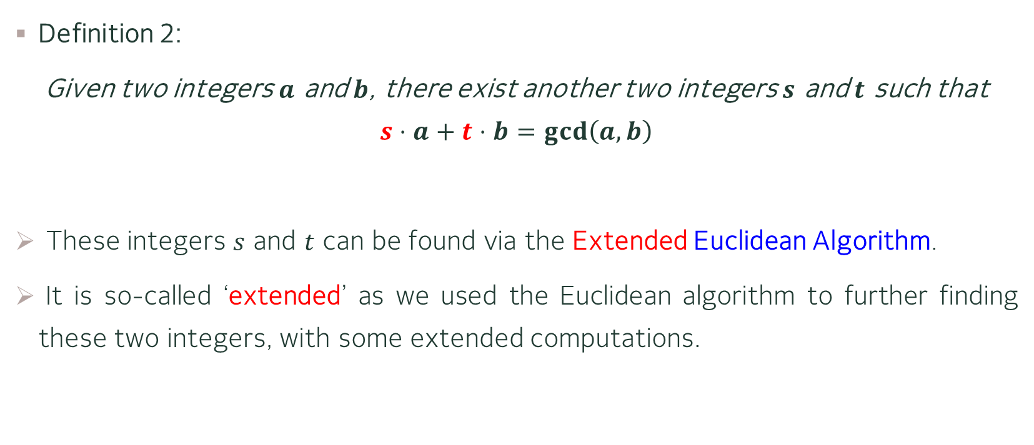
Divisibility – The Extended Euclidean Algorithm
Definition 2:
Given two integers $a$ and $b$, there exist another two integers $s$ and $t$ such that
$$s⋅a+t⋅b=\gcd\left(a,b\right)$$
These integers $s$ and $t$ can be found via the Extended Euclidean Algorithm.
It is so-called ‘extended’ as we used the Euclidean algorithm to further finding these two integers, with some extended computations.

Slide 19
Divisibility – The Extended Euclidean Algorithm

Slide 21
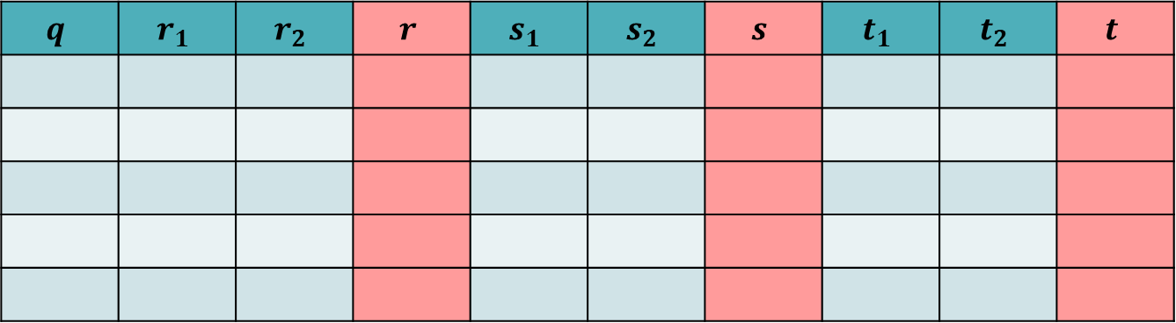

Divisibility – The Extended Euclidean Algorithm
Example 1: Find the $\gcd\left(161,28\right)$. Next, find the values of $s$ and $t$ such that
$$161⋅s+28⋅t=\gcd\left(161,28\right)$$
$$q$$ | $$r_{1}$$ | $$r_{2}$$ | $$r$$ | $$s_{1}$$ | $$s_{2}$$ | $$s$$ | $$t_{1}$$ | $$t_{2}$$ | $$t$$

Slide 22

Divisibility – The Extended Euclidean Algorithm
Example 1: Find the $\gcd\left(161,28\right)$. Next, find the values of $s$ and $t$ such that
$$161⋅s+28⋅t=\gcd\left(161,28\right)$$
Hence, we have $\gcd\left(161,28\right)=7$, $s=−1$ and $t=6$ such that
$$161\left(−1\right)+28\left(6\right)=7$$

Slide 23

Divisibility – The Extended Euclidean Algorithm
Example 2: Find the $\gcd\left(97,25\right)$. Next, find the values of $s$ and $t$ such that
$$97⋅s+25⋅t=\gcd\left(97,25\right)$$
$$q$$ | $$r_{1}$$ | $$r_{2}$$ | $$r$$ | $$s_{1}$$ | $$s_{2}$$ | $$s$$ | $$t_{1}$$ | $$t_{2}$$ | $$t$$

Slide 24
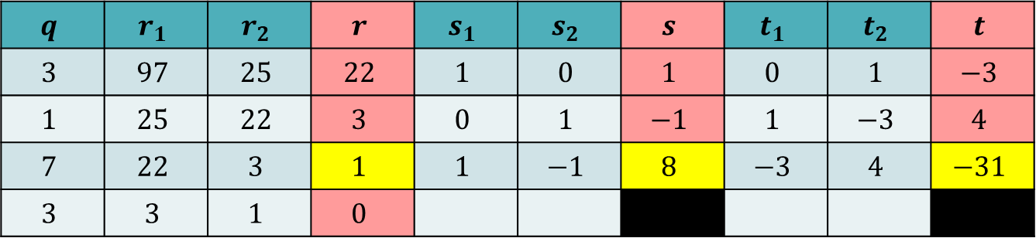

Divisibility – The Extended Euclidean Algorithm
Example 2: Find the $\gcd\left(97,25\right)$. Next, find the values of $s$ and $t$ such that
$$97⋅s+25⋅t=\gcd\left(97,25\right)$$
Hence, we have $\gcd\left(97,25\right)=1$, $s=8$ and $t=−31$ such that
$$97\left(8\right)+25\left(−31\right)=1$$
$$q$$ | $$r_{1}$$ | $$r_{2}$$ | $$r$$ | $$s_{1}$$ | $$s_{2}$$ | $$s$$ | $$t_{1}$$ | $$t_{2}$$ | $$t$$
$$3$$ | $$97$$ | $$25$$ | $$22$$ | $$1$$ | $$0$$ | $$1$$ | $$0$$ | $$1$$ | $$−3$$
$$1$$ | $$25$$ | $$22$$ | $$3$$ | $$0$$ | $$1$$ | $$−1$$ | $$1$$ | $$−3$$ | $$4$$
$$7$$ | $$22$$ | $$3$$ | $$1$$ | $$1$$ | $$−1$$ | $$8$$ | $$−3$$ | $$4$$ | $$−31$$
$$3$$ | $$3$$ | $$1$$ | $$0$$

Slide 25
MODULAR ARITHMETIC

Slide 26

Modular Operator
From division relation $a=q ⋅n+r$, we are now interested only on the remainder $r$ when $a$ is divided by $n$, This resembles the idea of modular arithmetic.
The modular operator, or simply $mod$when expressing such an arithmetic, and the remainder is often called a residue $r$.

Slide 27
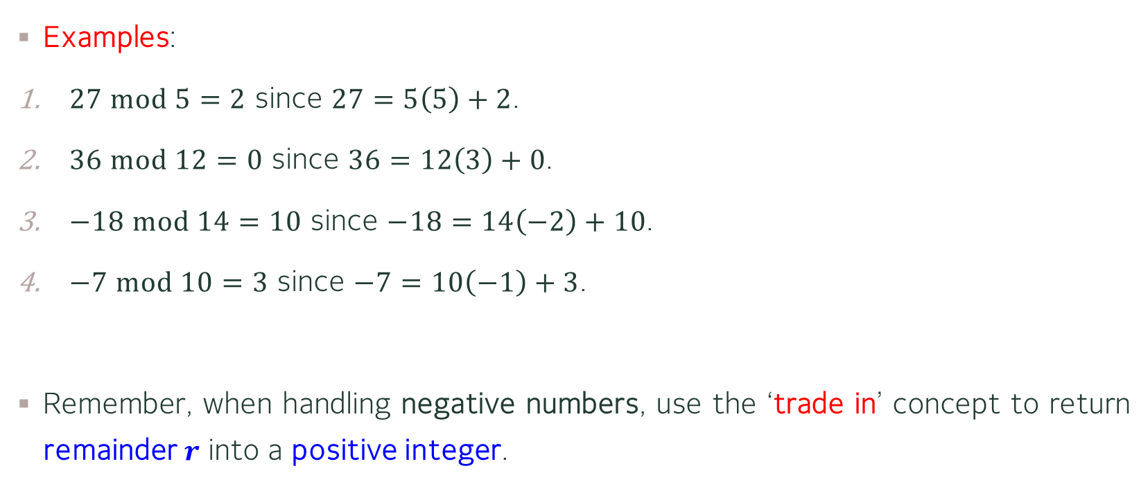
Modular Operator
Examples:
$27 mod 5=2$ since $27=5\left(5\right)+2$.
$36 mod 12=0$ since $36=12\left(3\right)+0$.
$−18 mod 14=10$ since $−18=14\left(−2\right)+10$.
$−7 mod 10=3$ since $−7=10\left(−1\right)+3$.
Remember, when handling negative numbers, use the ‘trade in’ concept to return remainder $r$ into a positive integer.

Slide 28

Modular Arithmetic – Set of Residues
Definition 3:
A set of least residues modulo $n$, or $ℤ_{n}$ is the set of Integers between 0 and $n−1$.
Examples:
$ℤ_{2}=\left\{0,1\right\}$
$ℤ_{7}=\left\{0,1,2,3,4,5,6\right\}$
$ℤ_{12}=\left\{0,1,2,3,4,5,6,7,8,9,10,11\right\}$

Slide 29
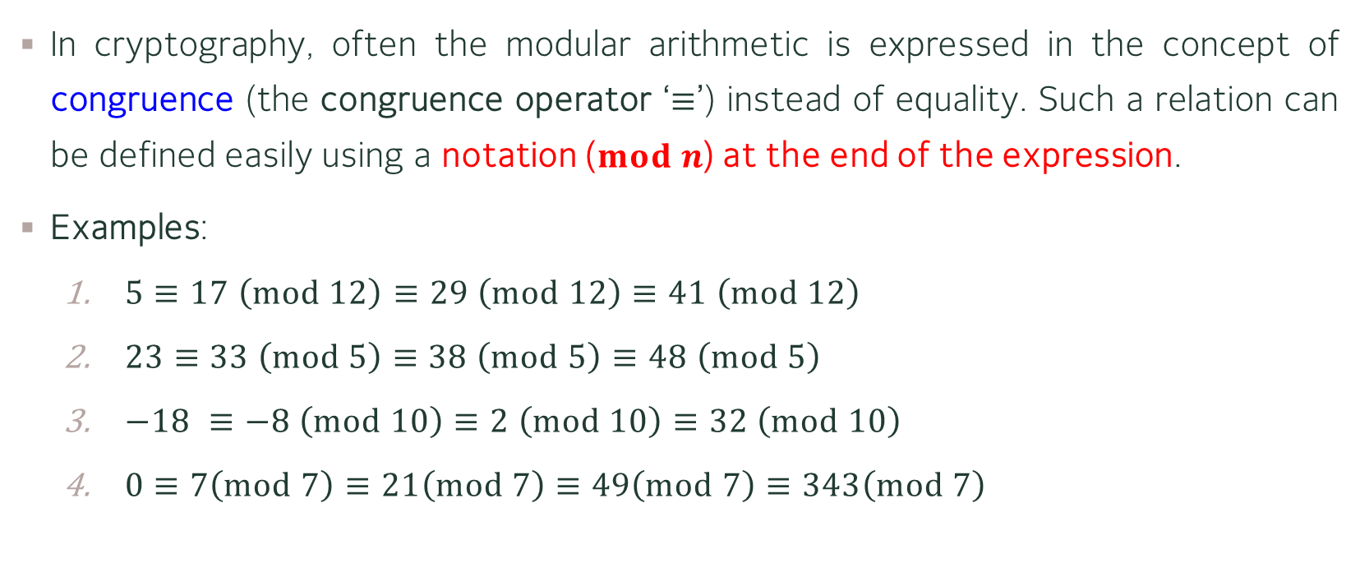
Modular Arithmetic – Congruence
In cryptography, often the modular arithmetic is expressed in the concept of congruence (the congruence operator ‘$≡$’) instead of equality. Such a relation can be defined easily using a notation ($mod n$) at the end of the expression.
Examples:
$5≡17 \left(mod 12\right)$ $≡29 \left(mod 12\right)≡41 \left(mod 12\right)$
$23≡33 \left(mod 5\right)≡38 \left(mod 5\right)$ $≡48 \left(mod 5\right)$
$−18 ≡−8 \left(mod 10\right)≡2 \left(mod 10\right)$ $≡32 \left(mod 10\right)$
$0≡7\left(mod 7\right)$ $≡21\left(mod 7\right)$ $≡49\left(mod 7\right)$ $≡343\left(mod 7\right)$

Slide 30

Modular Arithmetic – Congruence and Residue
Although one can cycle the modular operator endlessly, we are interested only in the relationship between the congruent modulo $n$ with the set of residue $ℤ_{n}$.
In other words, we are interested in finding the least positive integer modulo $n$ that is in the set of $ℤ_{n}$

Slide 31

Modular Arithmetic
Examples: Perform the following modular arithmetic
$\left(14+7\right) \left(mod 15\right)≡21 \left(mod 15\right)≡6$
$\left(3−14\right) \left(mod 8\right)≡−11 \left(mod 8\right)≡5$
$\left(7×5\right) \left(mod 13\right)≡35 \left(mod 13\right)≡9$
$\left(3+4×7\right) \left(mod 20\right)≡31 \left(mod 20\right)≡11$

Slide 32
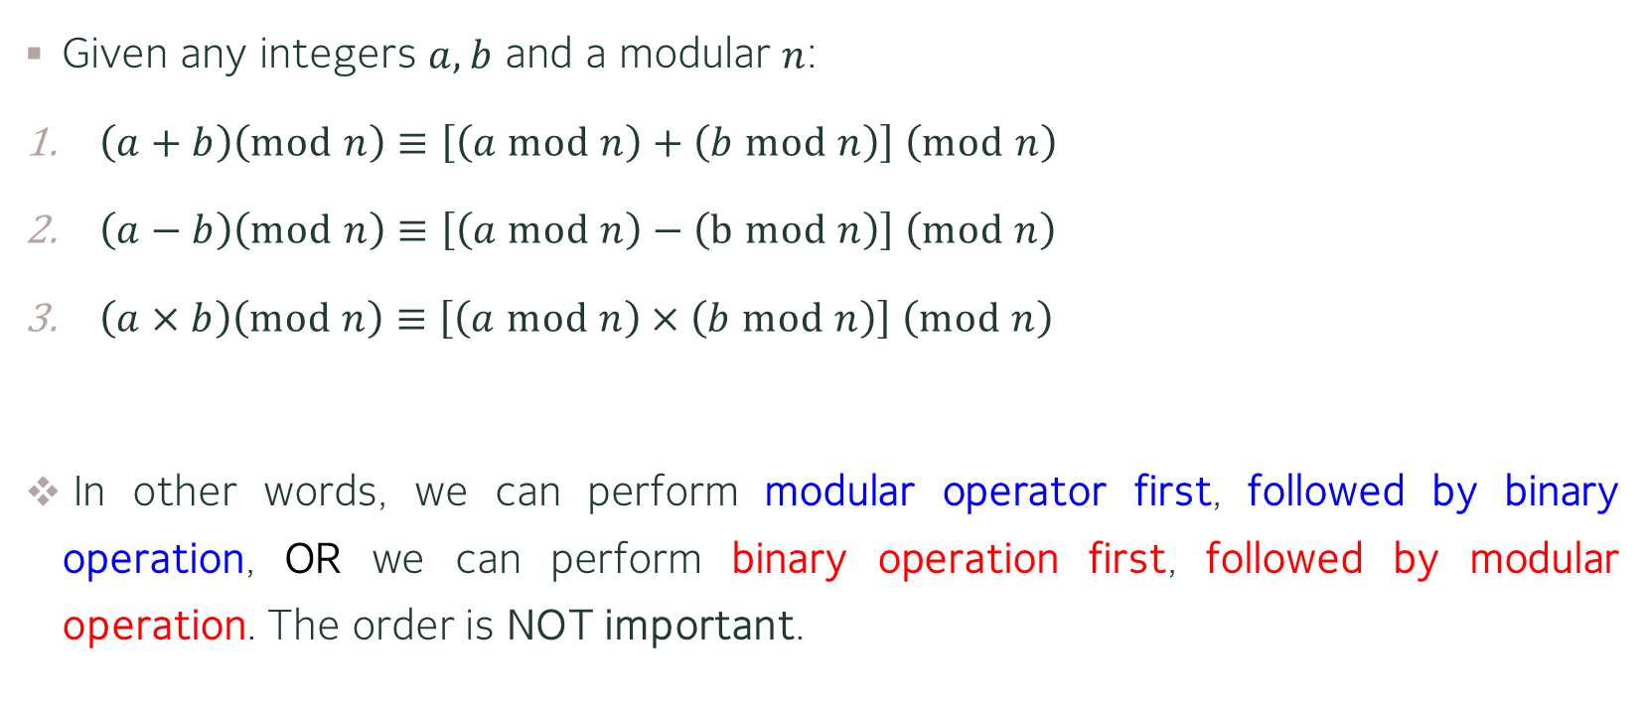
Modular Arithmetic – Properties
Given any integers $a,b$ and a modular $n$:
$\left(a+b\right)\left(mod n\right)≡\left[\left(a mod n\right)+\left(b mod n\right)\right] \left(mod n\right)$
$\left(a−b\right)\left(mod n\right)≡\left[\left(a mod n\right)−\left(b mod n\right)\right] \left(mod n\right)$
$\left(a×b\right)\left(mod n\right)≡\left[\left(a mod n\right)×\left(b mod n\right)\right] \left(mod n\right)$
In other words, we can perform modular operator first, followed by binary operation, OR we can perform binary operation first, followed by modular operation. The order is NOT important.

Slide 33
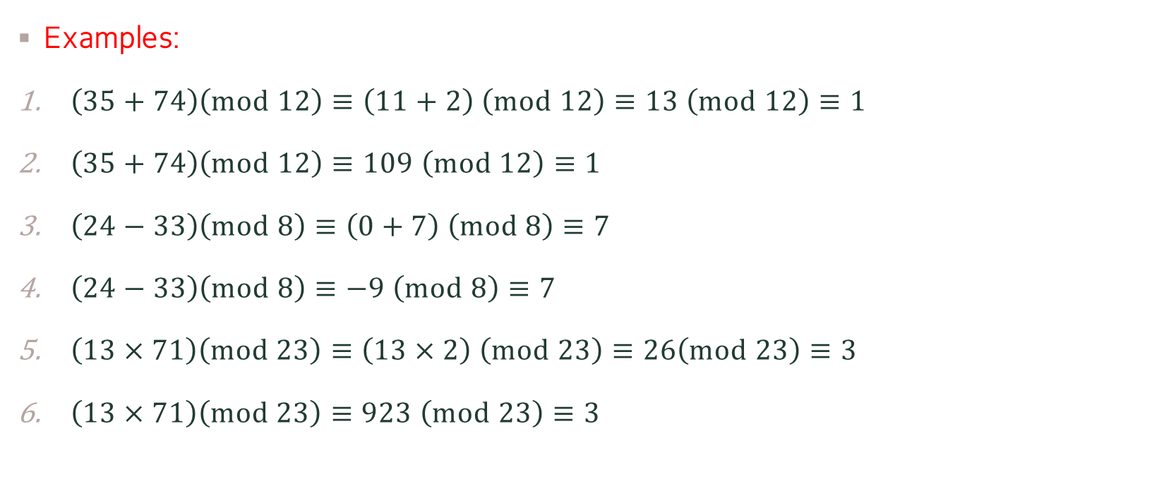
Modular Arithmetic – Properties
Examples:
$\left(35+74\right)\left(mod 12\right)≡\left(11+2\right) \left(mod 12\right)≡13 \left(mod 12\right)≡1$
$\left(35+74\right)\left(mod 12\right)≡109 \left(mod 12\right)≡1$
$\left(24−33\right)\left(mod 8\right)≡\left(0+7\right) \left(mod 8\right)≡7$
$\left(24−33\right)\left(mod 8\right)≡−9 \left(mod 8\right)≡7$
$\left(13×71\right)\left(mod 23\right)≡\left(13×2\right) \left(mod 23\right)≡26\left(mod 23\right)≡3$
$\left(13×71\right)\left(mod 23\right)≡923 \left(mod 23\right)≡3$
Did you notice the difference in each pair of examples?

Slide 34
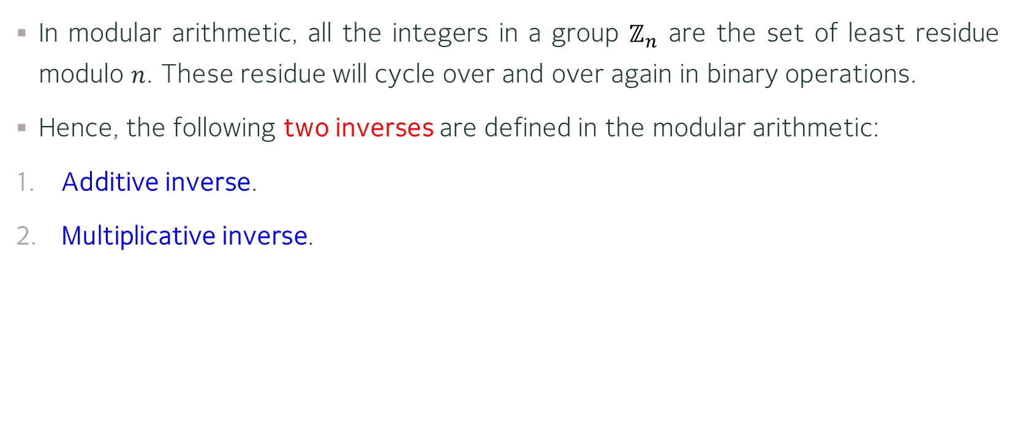
Modular Arithmetic – Inverses
In modular arithmetic, all the integers in a group $ℤ_{n}$ are the set of least residue modulo $n$. These residue will cycle over and over again in binary operations.
Hence, the following two inverses are defined in the modular arithmetic:
Additive inverse.
Multiplicative inverse.

Slide 35
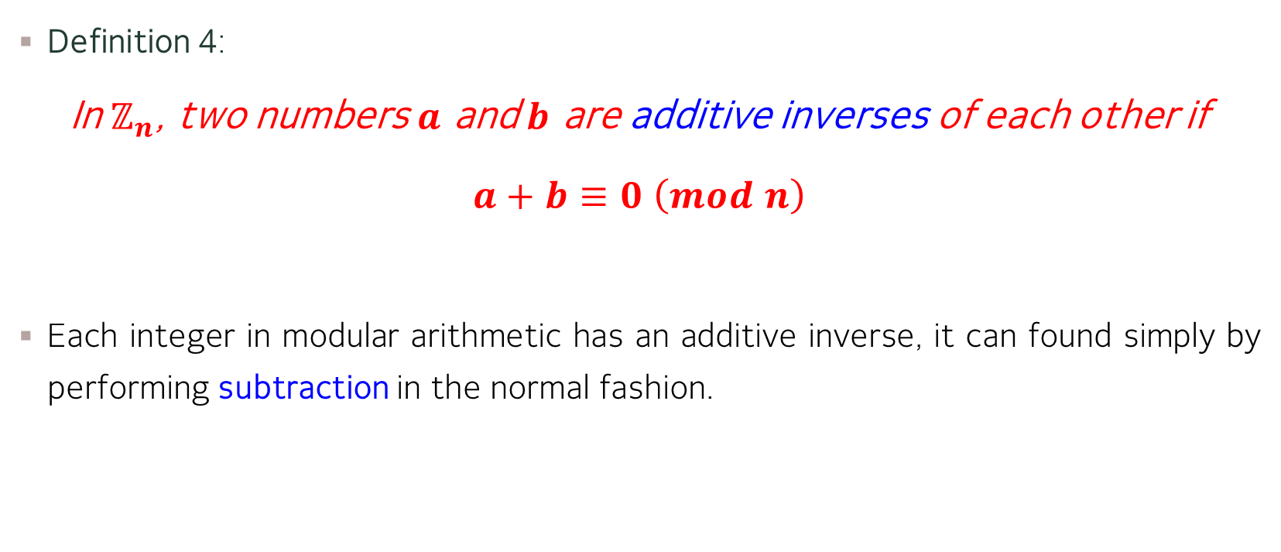
Modular Arithmetic – Additive Inverses
Definition 4:
In $ℤ_{n}$, two numbers $a$ and $b$ are additive inverses of each other if
$a+b≡0 \left(mod n\right)$
Each integer in modular arithmetic has an additive inverse, it can found simply by performing subtraction in the normal fashion.

Slide 36
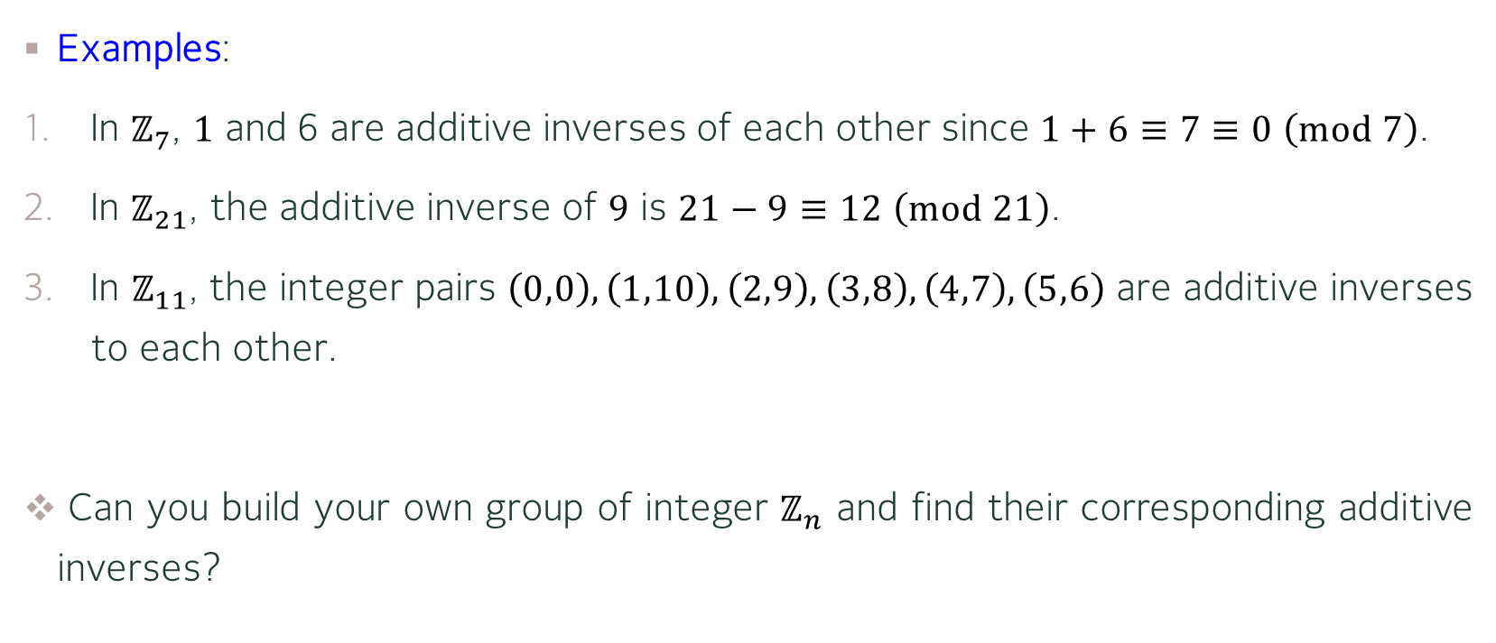
Modular Arithmetic – Additive Inverses
Examples:
In $ℤ_{7}$, $1$ and 6 are additive inverses of each other since $1+6≡7≡0 \left(mod 7\right)$.
In $ℤ_{21}$, the additive inverse of $9$ is $21−9≡12 \left(mod 21\right)$.
In $ℤ_{11}$, the integer pairs $\left(0,0\right),\left(1,10\right),\left(2,9\right),\left(3,8\right),\left(4,7\right),\left(5,6\right)$ are additive inverses to each other.
Can you build your own group of integer $ℤ_{n}$ and find their corresponding additive inverses?

Slide 37
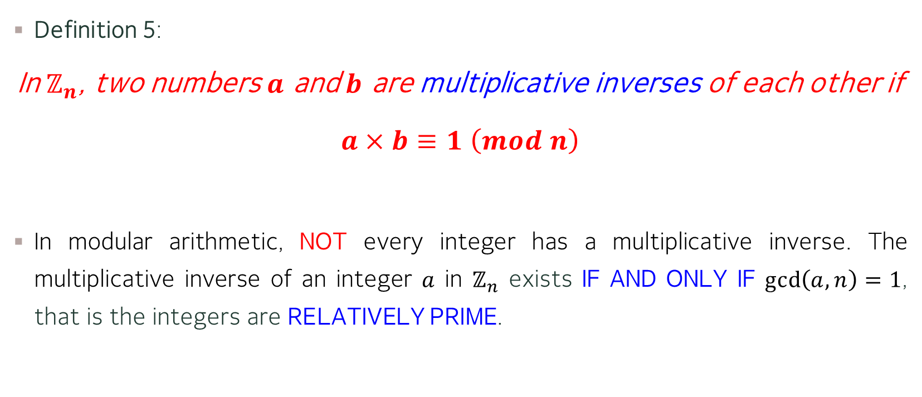
Modular Arithmetic – Multiplicative Inverses
Definition 5:
In $ℤ_{n}$, two numbers $a$ and $b$ are multiplicative inverses of each other if
$a×b≡1 \left(mod n\right)$
In modular arithmetic, NOT every integer has a multiplicative inverse. The multiplicative inverse of an integer $a$ in $ℤ_{n}$ exists IF AND ONLY IF $\gcd\left(a,n\right)=1$, that is the integers are RELATIVELY PRIME.

Slide 38
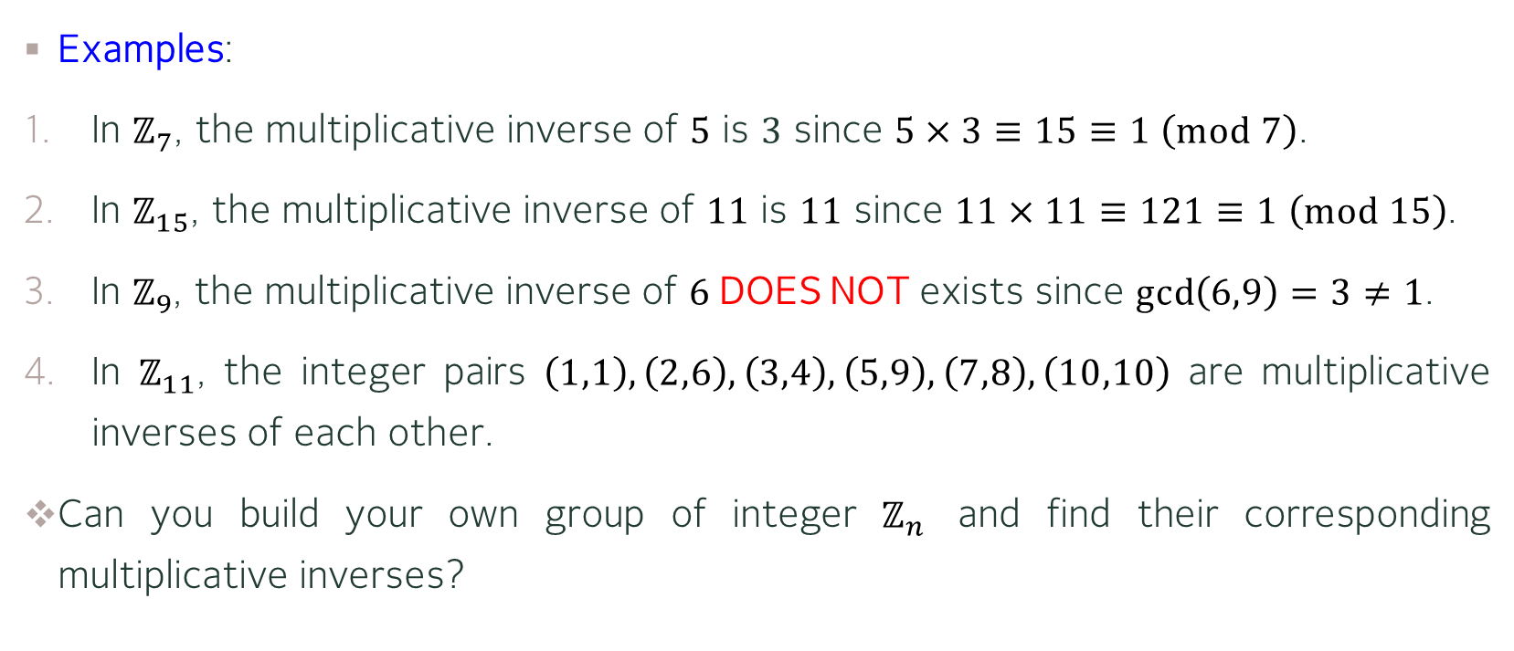
Modular Arithmetic – Multiplicative Inverses
Examples:
In $ℤ_{7}$, the multiplicative inverse of $5$ is $3$ since $5×3≡15≡1 \left(mod 7\right)$.
In $ℤ_{15}$, the multiplicative inverse of $11$ is $11$ since $11×11≡121≡1 \left(mod 15\right)$.
In $ℤ_{9}$, the multiplicative inverse of $6$DOES NOT exists since $\gcd\left(6,9\right)=3≠1$.
In $ℤ_{11}$, the integer pairs $\left(1,1\right),\left(2,6\right),\left(3,4\right),\left(5,9\right),\left(7,8\right),\left(10,10\right)$ are multiplicative inverses of each other.
Can you build your own group of integer $ℤ_{n}$ and find their corresponding multiplicative inverses?

Slide 39
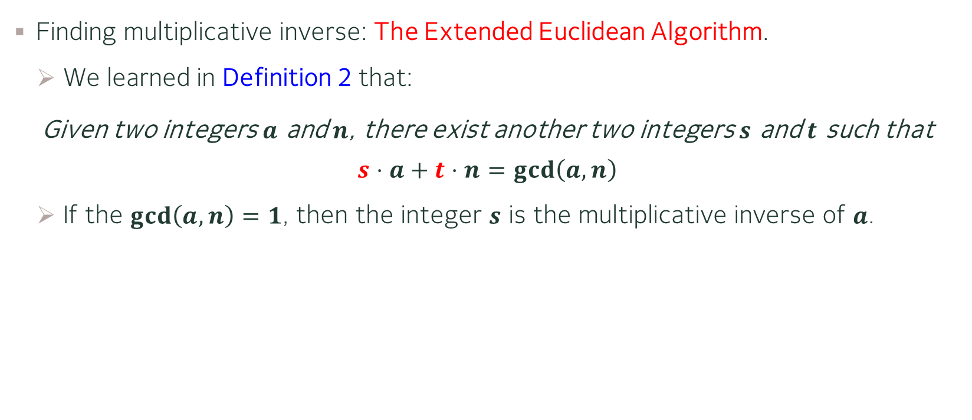
Modular Arithmetic – Multiplicative Inverses
Finding multiplicative inverse: The Extended Euclidean Algorithm.
We learned in Definition 2 that:
Given two integers $a$ and $n$, there exist another two integers $s$ and $t$ such that
$$s⋅a+t⋅n=\gcd\left(a,n\right)$$
If the $\gcd\left(a,n\right)=1$, then the integer $s$ is the multiplicative inverse of $a$.

Slide 40


Modular Arithmetic – Multiplicative Inverses
Example: Find the multiplicative inverse (if exists) of $25$ in $ℤ_{97}$.
Solution: By the Extended Euclidean Algorithm.
$$q$$ | $$r_{1}$$ | $$r_{2}$$ | $$r$$ | $$s_{1}$$ | $$s_{2}$$ | $$s$$ | $$t_{1}$$ | $$t_{2}$$ | $$t$$
$$3$$ | $$97$$ | $$25$$ | $$22$$ | $$1$$ | $$0$$ | $$1$$ | $$0$$ | $$1$$ | $$−3$$
$$1$$ | $$25$$ | $$22$$ | $$3$$ | $$0$$ | $$1$$ | $$−1$$ | $$1$$ | $$−3$$ | $$4$$
$$7$$ | $$22$$ | $$3$$ | $$1$$ | $$1$$ | $$−1$$ | $$8$$ | $$−3$$ | $$4$$ | $$−31$$
$$3$$ | $$3$$ | $$1$$ | $$0$$

Slide 41

Modular Arithmetic – Multiplicative Inverses
Example: Find the multiplicative inverse (if exists) of $25$ in $ℤ_{97}$.
Solution: By the Extended Euclidean Algorithm.
Since the $\gcd\left(25,97\right)=1$. Hence the multiplicative inverse of $25$ exists and is $−31≡66 \left(mod 97\right)$.
$$q$$ | $$r_{1}$$ | $$r_{2}$$ | $$r$$ | $$s_{1}$$ | $$s_{2}$$ | $$s$$ | $$t_{1}$$ | $$t_{2}$$ | $$t$$
$$3$$ | $$97$$ | $$25$$ | $$22$$ | $$1$$ | $$0$$ | $$1$$ | $$0$$ | $$1$$ | $$−3$$
$$1$$ | $$25$$ | $$22$$ | $$3$$ | $$0$$ | $$1$$ | $$−1$$ | $$1$$ | $$−3$$ | $$4$$
$$7$$ | $$22$$ | $$3$$ | $$1$$ | $$1$$ | $$−1$$ | $$8$$ | $$−3$$ | $$4$$ | $$−31$$
$$3$$ | $$3$$ | $$1$$ | $$0$$

Slide 42


Modular Arithmetic – Multiplicative Inverses
Exercise: Find the multiplicative inverse (if exists) of $13$ in $ℤ_{23}$.
Solution: By the Extended Euclidean Algorithm.
$$q$$ | $$r_{1}$$ | $$r_{2}$$ | $$r$$ | $$s_{1}$$ | $$s_{2}$$ | $$s$$ | $$t_{1}$$ | $$t_{2}$$ | $$t$$

Slide 43

Modular Arithmetic – Multiplicative Inverses
Exercise: Find the multiplicative inverse (if exists) of $13$ in $ℤ_{23}$.
Solution: By the Extended Euclidean Algorithm.
Since the $\gcd\left(13,23\right)=1$. Hence the multiplicative inverse of $13$ exists and is $−7≡16 \left(mod 23\right)$.
$$q$$ | $$r_{1}$$ | $$r_{2}$$ | $$r$$ | $$s_{1}$$ | $$s_{2}$$ | $$s$$ | $$t_{1}$$ | $$t_{2}$$ | $$t$$

Slide 44
MATRICES (Optional)

Slide 45

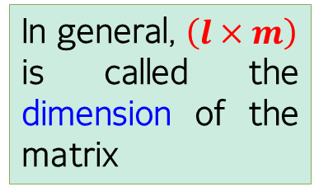
Matrices
Definition 6:
A matrix is a rectangular array with $\left(l×m\right)$ elements, in which $l$ indicates the number of ROWs and $m$ indicates the number of COLUMNs.
In general, $\left(l×m\right)$ is called the dimension of the matrix

Slide 46
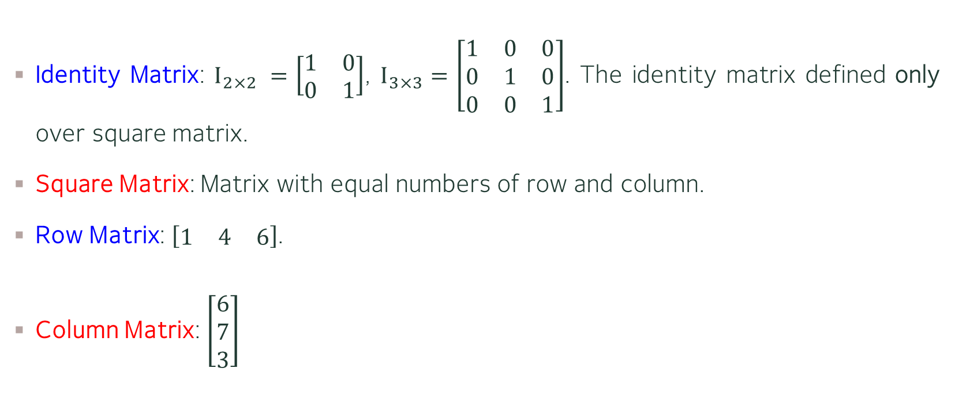
Matrices – Types of Matrices
Identity Matrix: $I_{2×2} =\left[\begin{matrix}1 & 0 \\ 0 & 1\end{matrix}\right]$, $I_{3×3}=\left[\begin{matrix}1 & 0 & 0 \\ 0 & 1 & 0 \\ 0 & 0 & 1\end{matrix}\right]$. The identity matrix defined only over square matrix.
Square Matrix: Matrix with equal numbers of row and column.
Row Matrix: $\left[\begin{matrix}1 & 4 & 6\end{matrix}\right]$.
Column Matrix: $\left[\begin{matrix}6 \\ 7 \\ 3\end{matrix}\right]$

Slide 47
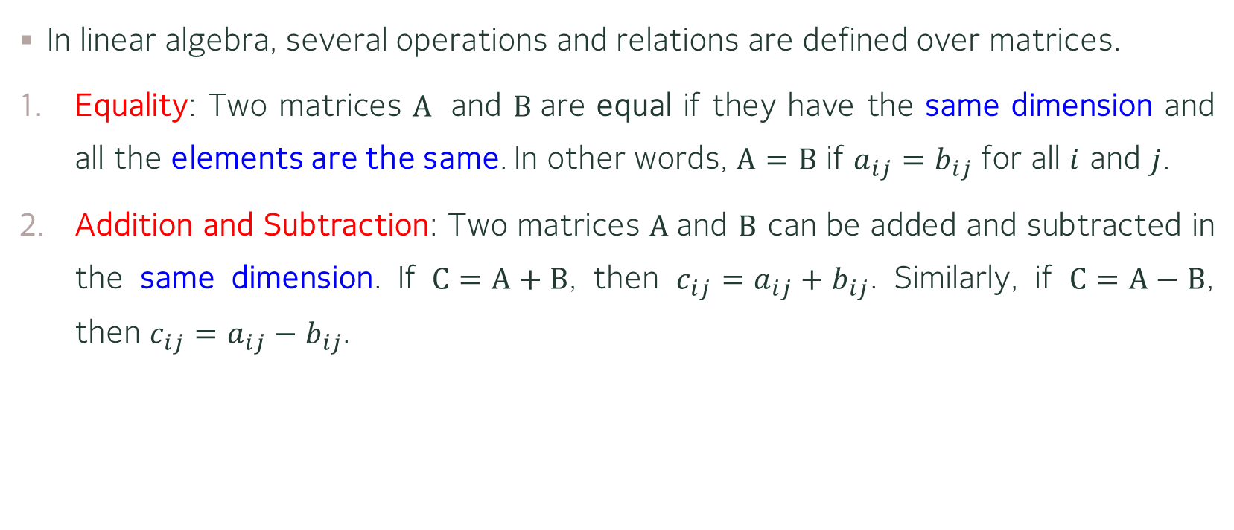
Matrices – Operations and Relations
In linear algebra, several operations and relations are defined over matrices.
Equality: Two matrices $A$ and $B$are equal if they have the same dimension and all the elements are the same. In other words, $A=B$ if $a_{ij}=b_{ij}$ for all $i$ and $j$.
Addition and Subtraction: Two matrices $A$and $B$ can be added and subtracted in the same dimension. If $C=A+B$, then $c_{ij}=a_{ij}+b_{ij}$. Similarly, if $C=A−B$, then $c_{ij}=a_{ij}−b_{ij}$.

Slide 48
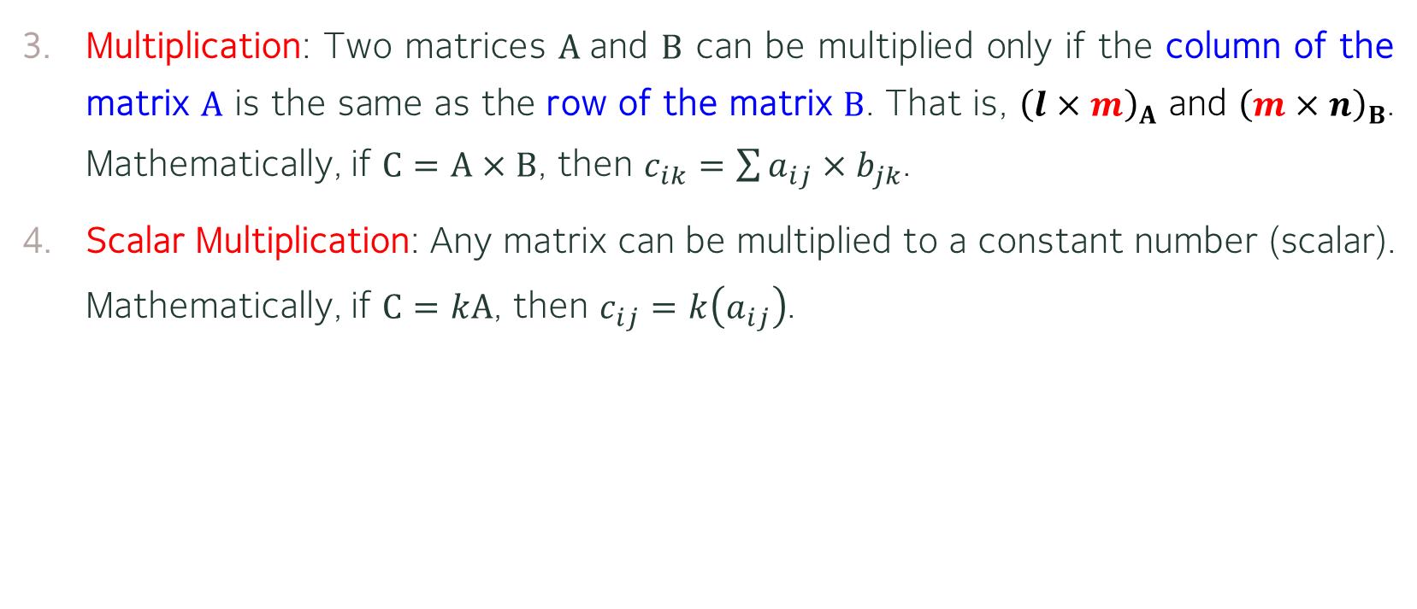
Matrices – Operations and Relations
Multiplication: Two matrices $A$and $B$ can be multiplied only if the column of the matrix $A$ is the same as the row of the matrix $B$. That is, ${\left(l×m\right)}_{A}$ and ${\left(m×n\right)}_{B}$. Mathematically, if $C=A×B$, then $c_{ik}=\sum{a_{ij}×b_{jk}}$.
Scalar Multiplication: Any matrix can be multiplied to a constant number (scalar). Mathematically, if $C=kA$, then $c_{ij}=k\left(a_{ij}\right)$.

Slide 49

Matrices – Operations and Relations
Examples:
$\left[\begin{matrix}1 & 4 & 6\end{matrix}\right]+\left[\begin{matrix}6 & 8 & 7\end{matrix}\right]=\left[\begin{matrix}7 & 12 & 13\end{matrix}\right]$.
$\left[\begin{matrix}6 \\ 7 \\ 3\end{matrix}\right]−\left[\begin{matrix}4 \\ 9 \\ 0\end{matrix}\right]=\left[\begin{matrix}2 \\ −2 \\ 3\end{matrix}\right]$.
$\left[\begin{matrix}1 & 3 & 2 \\ 7 & 4 & 1\end{matrix}\right]×\left[\begin{matrix}2 & 4 \\ 7 & 6 \\ 5 & 1\end{matrix}\right] =\left[\begin{matrix}2+21+10 & 4+18+2 \\ 14+27+5 & 28+24+1\end{matrix}\right]=\left[\begin{matrix}33 & 24 \\ 46 & 53\end{matrix}\right]$
$5\left[\begin{matrix}6 & 8 & 7\end{matrix}\right]=\left[\begin{matrix}30 & 40 & 35\end{matrix}\right]$

Slide 50
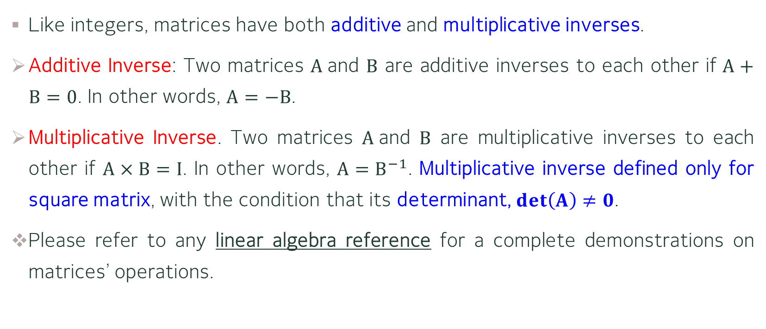
Matrices – Determinant and Inverses
Like integers, matrices have both additive and multiplicative inverses.
Additive Inverse: Two matrices $A$and $B$ are additive inverses to each other if $A+B=0$. In other words, $A=−B$.
Multiplicative Inverse. Two matrices $A$and $B$ are multiplicative inverses to each other if $A×B=I$. In other words, $A=B^{−1}$. Multiplicative inverse defined only for square matrix, with the condition that its determinant, $det\left(A\right)≠0$.
Please refer to any linear algebra reference for a complete demonstrations on matrices’ operations.

Slide 51
Matrices
In this course, we do not cover much about Matrices, since the only function of this concept is to learn how to operate the classical cipher in the next chapter.

Slide 52
Main References for Chapter 2
Forouzan, B.A. “Introduction to Cryptography and Network Security”, Third Edition, McGraw-Hill, 2008.

Slide 53
~ THE END ☺ ~

